Slide 1
Storing & Managing Data
Jeremy Bergmann - Omaha Data Science Academy

Slide 2
Quiz: Class 1&2
Creating new datasets & Combine disparate data sets
Perform common queries, aggregations, and joins
Adding, removing, or modifying data
Extracting and Storing Data
Creation/Extraction
Transformation data
Cleaning data
Storage & Retrieval
Notes:
Creation: creating tables and databases, the things
Storage: where data are stored
Cleaning: adding, removing, or modifying data
Retrieval: selecting only the data you want

Slide 3
Class 3 Objectives
Enterprise Data - Overview
Data Storage Terminology
Data Management vs. Administration (DBA) Data Governance & Measuring Data Quality
Data Dictionary
Cleaning Data – Purpose & Goals
SQL Cleaning: Wildcards, Case Statements, Duplicates
SQL Formatting: String, Date & Numeric Functions
Notes:
Feynman technique: Learn -> Explain -> Reflect -> Repeat
What are the most important ideas from last class? Write a summary of the information as if explaining to a 14 year old. Avoid jargon Keep the words and sentences simple Rely on memory Make the explanation visual, if possible Note where you had difficulty or have knowledge gaps. These indicate things you should review, research, or ask questions about

Slide 4
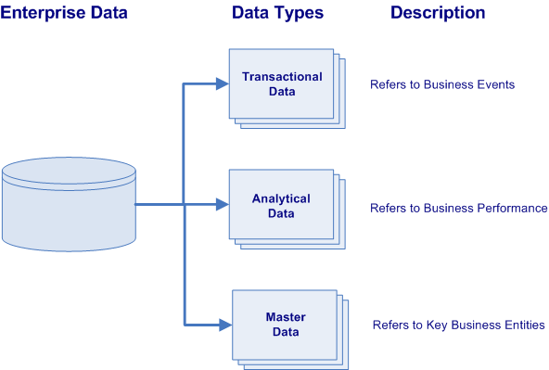
Types of Enterprise Data
All business enterprises have three varieties of physical data located within their numerous information systems. These varieties of data are characterized by their data types and their purpose within the organization.
Transactional Data describes the business events of an organization
Analytical Data supports decision making, reporting, query, and analysis (i.e. describes business performance).
Master Data represents the key business entities upon which transactions are executed and the dimensions around which analysis is conducted (i.e. describes key business entities).
Notes:
Transactional data supports the daily operations of an organization (i.e. describes business events).
Analytical data supports decision-making, reporting, query, and analysis (i.e. describes business performance).
While master data represents the key business entities upon which transactions are executed and the dimensions around which analysis is conducted (i.e. describes key business entities).
lowest granularity

Slide 5
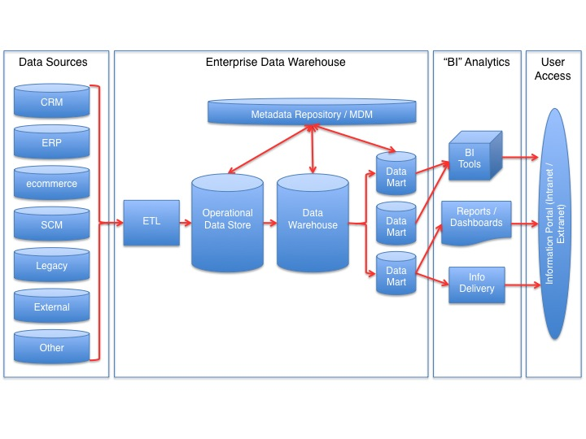
Data Storage Terminology
OLTP - Focused on the operation of a particular system - goal is to capture events.
ODS - “pulls together” data from multiple transaction processing systems and sources. Usually contains cleaned, “normalized” data
OLAP - capabilities to analyze data from multi-dimensional perspectives. Usually contains “denormalized” data
MDM: Define and manage the critical data of an organization to provide, with data integration, from a single point of reference.
Semantic Layer
(ODS)
Online Analytical Processing
(OLAP)
Online Transactional Processing
(OLTP)
Notes:
Relationship: OLTP = Source for OLAP

Slide 6
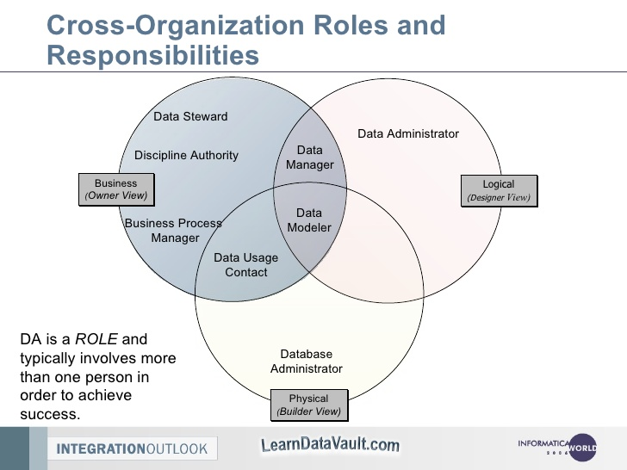
Data Management vs. DBA
What is Data Management?
Data Management (Stewardship) is the practice of organizing and maintaining data processes to meet ongoing information lifecycle needs. This includes data creation, storage, processing, archiving, and data destruction.
What is Database Administration (DBA)?
Database administration is the use of specialized software to store and organize data. This is the technical aspects of the planning, installation, configuration, design, migration, performance monitoring, security, troubleshooting, backup, and data recovery of a database system.
What are the Similarities Between the Two Roles?
Professionals in both specializations have to coordinate the database planning, goals, design, and communicate with each other while the project is being implemented.
What are the Differences?
Data management focuses on the “Logical” design - planning, organization, and design of a database system. DBA’s focus in the physical design of the database performance, storage, access, backups, etc.
Notes:
Approaches to data management eventually permeated what came to be known as the data lifecycle, spanning data creation, storage, processing, archiving and, sometimes, data destruction.

Slide 7
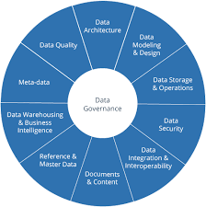
Data Governance
What is Data Governance?
Data Governance is a quality control discipline for assessing, managing, using, improving, monitoring, maintaining, and protecting organizational information.
Who Needs Data Governance?
Organizations that need to prevent sensitive information from being accessed by unauthorized users.
What is a Data Steward?
This is a position within an organization that ensures data governance processes are followed, guidelines are enforced, and recommends improvements to be made to data governance processes.
Notes:
It is a system of decision rights and accountabilities for information-related processes, executed according to agreed-upon models which describe who can take what actions with what information, and when, under what circumstances, using what methods

Slide 8
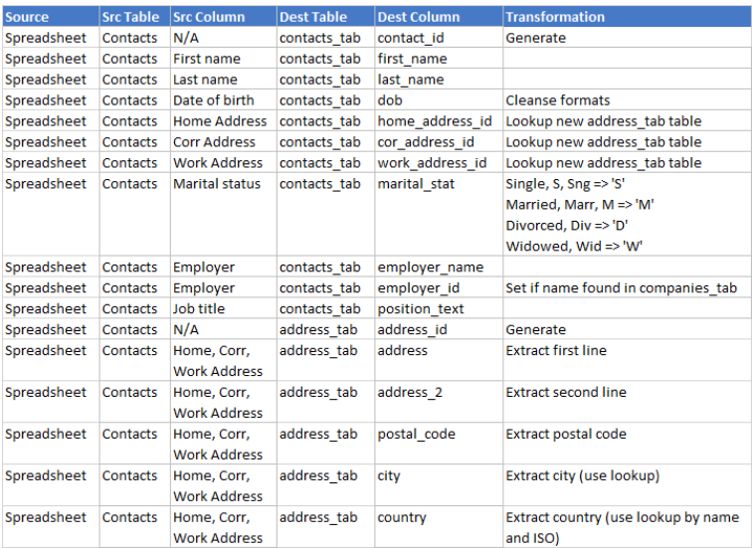
Data Dictionaries
What is a Data Dictionary?
A Data Dictionary is a collection of sources, names, definitions, and attributes about data elements that define the data captured in a system.
Enterprise Data Dictionaries contain the following Information:
Names and physical information of all database schemas, tables and fields.
“System of record” information.
Table constraints such as primary key attributes, foreign key information etc.
Business rules, transformations and metadata about field values.

Slide 9
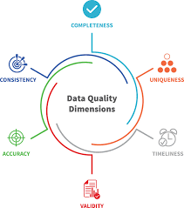
Measuring Data Quality
What is Data Quality?
Sometimes errors or incorrect elements are present in your data set. It’s important to be proactive and clean your data and periodically test it for inaccuracies.
What is a Data Quality Assessment?
You can identify these errors and understand their implications by both qualitative assessments and quantitative measurement. This ensures you have quality data on hand when you run your jobs. This will let you improve your data quality processes for quality and effectiveness.
What is an Example of Measuring Data Quality?
This is a common type of data quality metric. It allows you to track how the number of known errors – such as missing, incomplete or redundant entries – within a data set corresponds to the size of the data set. If you find fewer errors while the size of your data stays the same or grows, you know that your data quality is improving.

Slide 10
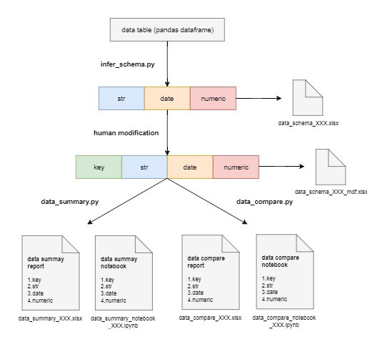
Data Quality w/Python
There are ways to monitor and measure data quality with Python. Some of these libraries can help with the following tasks:
Data Integration
Data Cleansing
Data Monitoring
Data Auditing
Investigating Unknown Datasets
To the right, you can see an example of a Python library: pydqc.
You can use libraries like this to set up a notebook to
import libraries like pandas to clean data, numpy to run
calculations, and pydqc to add automatic data quality checks.
It lets you load the data (CSV), infer the schema of your
database, and generate a summary of your data.
Library Documentation and Examples
https://github.com/SauceCat/pydqc
https://github.com/SauceCat/pydqc/blob/master/test/pydqc_test_on_Zillow.ipynb

Slide 11
Cleaning Data Using SQL
Jeremy Bergmann - Omaha Data Science Academy

Slide 12
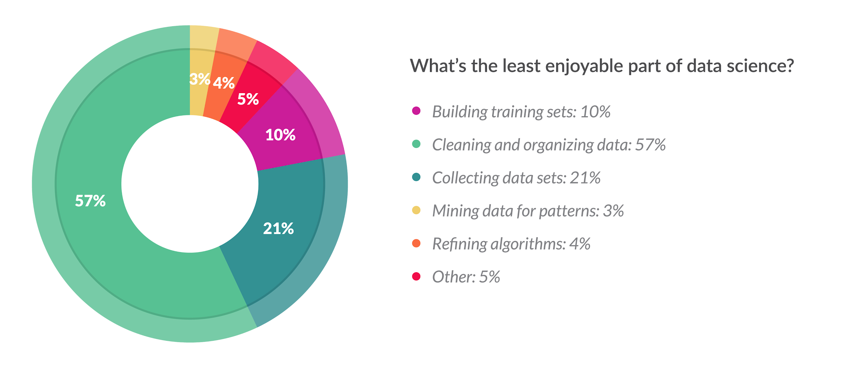
Cleaning Data
What Does Cleaning Data Mean?
Data cleaning is the process of confirming the Validity, Accuracy, Completeness, Consistency, and Uniformity data
How Can You Clean Data?
Using business knowledge, along with software tools or a coding language to clean data.
What About Programming Languages?
Cleaning data in a language like SQL or Python gives you flexibility to run routines for specific projects, while keeping costs low
Python (Appendix A): Pandas, Dora, data cleaner, tabulate, scrubadub, and many other Python libraries.
SQL: T-SQL, Text & Date Functions, Case Statements, “Where” clause, Select Distinct
Notes:
Validity - absence of differences between the data items representing the same objects based on specific information requirements
Accuracy - degree to which the data item correctly describes the object in context of appropriate real-world context and attributes
Completeness - An indication of the comprehensiveness of available data,
Consistency - absence of differences between the data items representing the same objects based on specific information requirements (across data sources/Tables)
Uniformity - Absolute, or very high degree of, comparability between two or more alternatives, processes, products, qualifications, sets of data

Slide 13
Goals of Cleaning Data
Remove Unwanted Observations
Duplicate Observations arise when combining datasets from multiple places, scrape data, and receive data from clients/other departments.
Irrelevant Observations & Outliers are those that don’t fit the specific problem you’re trying to solve. It may be useful in other projects, but not this particular one.
Fix Structural Errors that occur during collection, measurement or data transfer.
Parsing is an example of finding syntax errors.
Handle Missing Data is a must. It’s bad practice to ignore missing values in your dataset, because many algorithms do not accept missing values. You have two options when handling missing data:
Dropping observations that have missing values
Imputing the missing values based on other observations. Appending is a method of cross-referencing multiple data sources and combining known data into a final data.
There are other possible ways to clean data, such as, transforming files, applying statistical methods, and post-processing, but these three steps will always be performed on any dataset you will analyze.
Notes:
The goal of cleaning is ultimately to confirm the Validity, Accuracy, Completeness, Consistency, and Uniformity of the dataset

Slide 14
Case Statements
Purpose - The CASE statement goes through conditions and return a value when the first condition is met (like an IF-THEN-ELSE statement). If no conditions are true, it returns the value in the “ELSE” clause.
Syntax
CASE WHEN condition1 THEN result1 WHEN condition2 THEN result2 WHEN conditionN THEN resultN ELSE result END;
Example
SELECT view.Country,
CASE WHEN Country = 'India' THEN 'Gandhi'
WHEN Country = 'Nepal' THEN 'Mt. Everest'
WHEN Country = 'China' THEN 'Great Wall'
ELSE 'Unknown' end as famous_stuff
FROM world.vw_countries_asia as view
WHERE view.Country in ('India', 'China', 'Nepal','Taiwan')

Slide 15
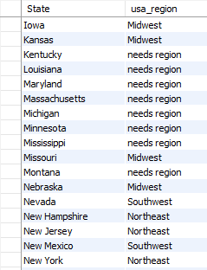
Ex. SQL Wildcards & Case Statement
Classify US States into their geographical “regions”
SQL Query
SELECT distinct District as State,
case when District in ('Nebraska','Iowa','Missouri','Kansas') then 'Midwest'
when District = 'New Mexico' or District = 'Nevada' then 'Southwest'
when District like ('N_w%') then 'Northeast'
when District like ('%Dakota') then 'Midwest'
else 'needs region' end as usa_region
FROM world.city
where CountryCode='USA'
order by State
Legend - Wild Cards, Distinct
Notes:
“Main clauses” in descending order of operations
LIKE: wildcard searches: %<char>, %<char>%, <char>%, underscores
Wildcard characters: %, _, *
CASE: if-then statements
JOIN: mostly use INNER, LEFT
HAVING: WHERE for groups (http://www.mysqltutorial.org/mysql-having.aspx)
BETWEEN is inclusive

Slide 16
SQL Wildcards
Purpose: Used with the SQL “Like” operator, A wildcard character is used to for comparing strings or for string-cleaning purposes.
Symbol | Description | Example
% | Represents zero or more characters | bl% finds bl, black, blue, and blob
_ | Represents a single character | h_t finds hot, hat, and hit
[] | Represents any single character within the brackets | h[oa]t finds hot and hat, but not hit
^ | Represents any character not in the bracket | h[^oa]t finds hit, but not hot and hat
- | Represents a range of characters | c[a-b]t finds cat and cbt
Notes:
“Main clauses” in descending order of operations
LIKE: wildcard searches: %<char>, %<char>%, <char>%, underscores
Wildcard characters: %, _, *

Slide 17

Removing Duplicates
Purpose - Improve the Accuracy, Consistency and the Uniformity of data by removing identical observations that appear more than 1 time in a SQL Table.
3 Methods
1. Select “Distinct” Keyword
2. Finding Duplicates by Key (joins)
3. Finding Duplicates via Aggregation
Notes:
https://codingsight.com/multiple-ways-to-remove-duplicates-from-sql-tables/

Slide 18
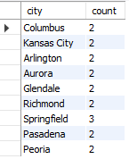
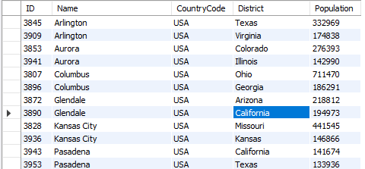
Ex. Identifying Duplicates
Find USA Cities with the same name (duplicate records)
SQL Query - Find Via Aggregate & Join
SELECT a.*
FROM world.city a inner join
(SELECT `Name` as city, sum(1) as count
FROM world.city
where CountryCode='USA'
Group by `Name`
Having count > 1) as b on a.Name = b.city
where a.CountryCode='USA'
order by a.Name
Notes:
“Main clauses” in descending order of operations
LIKE: wildcard searches: %<char>, %<char>%, <char>%, underscores
Wildcard characters: %, _, *
CASE: if-then statements
JOIN: mostly use INNER, LEFT
HAVING: WHERE for groups (http://www.mysqltutorial.org/mysql-having.aspx)
BETWEEN is inclusive

Slide 19
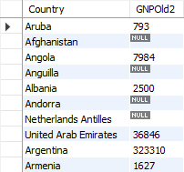
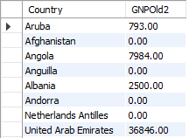
Ex. Numeric Functions
Fill-in and convert `GNPOld` values in World.Country
SQL Query - Undesired Types - Convert Decimal to Integer
SELECT Name as Country, convert(round(GNPOld,0),unsigned) as GNPOld2 FROM world.country;
SQL Query - Coalesce “0” for Null Values
SELECT Name as Country, coalesce(GNPOld,0) as GNPOld3 FROM world.country;

Slide 20
Numeric Formatting Functions
Function | Description | Example
FORMAT (N, D) | Number N to a format like ‘#,###,###.##’ rounded to a number of decimal places | SELECT FORMAT(12324.2573, 3) = 12,324.257
CAST (value, type) | The CAST() function converts a value (of any type) into the specified datatype. | SELECT CAST ('150' AS Unsigned)= 150
IFNULL(expr ,alt_value) | returns a specified value if the expression is NULL. | IFNULL(NULL, 500) = 500
ISNULL(exp) | returns 1 or 0 depending on whether an expression is NULL. | ISNULL(NULL) = 1
COALESCE (val1, val2, ...., val_n) | Function returns the first non-null value in a list. | COALESCE(NULL, NULL, NULL, 'W3Schools.com', NULL, 'Example.com') = 'W3Schools.com'
Notes:
See more numeric functions at: https://www.w3resource.com/slides/mysql-mathematical-functions-slides-presentation.php
For Cast() data types, see: https://www.w3resource.com/slides/mysql-mathematical-functions-slides-presentation.php

Slide 21
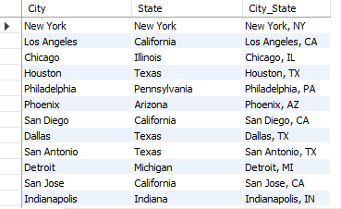
Ex. String Functions
Convert USA City & State Names to “City, St.” in World.City
SQL Query
SELECT `Name` as City, District as State ,
concat(`Name`, ‘,',
case when District = 'New York' then 'NY'
when trim(Leading 'Penn' from District) = 'sylvania' then 'PA'
when instr(District,'Tex') then 'TX'
when District = 'Arizona' then Replace(District, 'Arizona', 'AZ')
else upper(left(District,2)) end
) as City_State
FROM world.city as a where a.CountryCode='USA'

Slide 22
String Formatting Functions
Function | Description | Example
CONCAT (Str1,..,StrN) | add two or more strings | SELECT CONCAT(“Jeremy “,”Bergmann”) = ‘Jeremy Bergmann’
INSTR (orig, substr) | Returns an integer which indicates the position of the first occurrence of the substr. | INSTR('myteststring','st') = 5
TRIM (expr ,alt_value) | string after removing all prefixes or suffixes from the given string. | TRIM(LEADING 'leading' FROM 'leadingtext' ) = ‘text’
REPLACE (str, find, sub) | replaces all the occurrences of a substring within a string | REPLACE('w3resource','ur','r') = ‘w3resorce’
LCASE(str), UCASE(str) | converts the characters of a string to lower/upper case characters. | LCASE('MYTESTSTRING') = ‘myteststring’
LENGTH(str) | returns the length of a given string. | Length(‘Bergmann’) = 8
SUBSTRING
Notes:
See more numeric functions at: https://www.w3resource.com/slides/mysql-mathematical-functions-slides-presentation.php
For Cast() data types, see: https://www.w3resource.com/slides/mysql-mathematical-functions-slides-presentation.php

Slide 23
Date Formatting Functions
Function | Description | Example
CURDATE() | returns the current date in 'YYYY-MM-DD' format | SELECT CURDATE() = '2019-07-22'
CURRENT_TIMESTAMP() | eturns the current date and time in ‘YYYY-MM-DD HH:MM:SS’ format | CURRENT_TIMESTAMP() = ‘2019-07-22 13:41:53’
HOUR(time) | returns a specified value if the expression is NULL. | HOUR(CURRENT_TIMESTAMP()) = 13
Datediff (date1, date2) | Returns the number of days between two dates or datetimes (using only date portion) | Datediff(CURDATE(), ‘1999-12-31’) = 7143
DAYOFWEEK (date) | returns the week day number (1 for Sunday,2 for Monday …… 7 for Saturday ) | DAYOFWEEK(CURDATE()) = 2
DAY(date), Month(date), Year(date) | following statement will return the day of the month/month of year/calendar year of the input date. | DAY('2008-05-15') = 15 MONTH('2008-05-15') = 5 YEAR('2008-05-15') = 2008
Notes:
See more numeric functions at: https://www.w3resource.com/slides/mysql-mathematical-functions-slides-presentation.php
For Cast() data types, see: https://www.w3resource.com/slides/mysql-mathematical-functions-slides-presentation.php

Slide 24
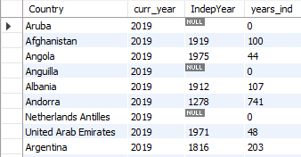
Ex. Date Functions
Get the number of years since each country’s independence
SQL Query
SELECT `name` as Country, year(curdate()) as curr_year, IndepYear,
case when IndepYear is null then 0
else year(curdate())-IndepYear end as years_ind
FROM world.country;

Slide 25
Project Milestones
Import data into MySQL database (Class 1)
Query Data for Data Understanding/Relevant Information (Class 1)
Storing/Joining data for analysis (Class 2)
Cleaning Data for Analysis (Class 3)
Analyze Data Quality & Create Data Dictionary (Class 3)
Normalize Data & Create Data Model (Class 4)
Connect MySQL to Data Visualization Tool, Answer Business Questions, Automate data workflow using ETL (Class 5)

Slide 26

Class Project
Data Dictionary
1. Create a Data Dictionary for the “Consoles” schema, highlighting the original data source, database schema/table, fields values/types and business significance.
Power BI - Connect
1. Import the views you created in the “Consoles” schema into Power BI’s “Relationships” view.
2. Re-Create the entity relationships in last week’s ERD, by adding relationships via the data modeling view in Power BI.
Data Quality (Extra Credit)
1. Analyze Data Quality with Python code, via the Jupyter notebook (Python_DataQuality.ipynb) located in the “Examples” folder.
Notes:
If error that cant find python library: https://stackoverflow.com/questions/43437884/jupyter-notebook-import-error-no-module-named-matplotlib

Slide 27
Class Project
Cleaning Data
The COO would like to know the volume of existing pre-orders for console games, to predict the most popular upcoming game genres. Utilize and clean the “USA Pre-Order Chart” data to answer this question.
1. Use the “USA_PreOrders_Import.sql” file to create a table populated with preorder data, in the “Class Project/Consoles” folder.
2. Create a “USA_PreOrder_Chart” view that cleans-up the following data.
Change the “N/A” values in the “Weeks to Launch” column to 30, then cast the field as an Integer
Create “Console”, “Company” and “Genre” fields from the text in “Game_Console_Company_Genre”
For 1-10, Fill-In the “Game” & “Genre” columns with relevant values
Calculate the difference between today and the date the preorder list was last published. (‘2018-12-29’)
4. Select “Genre” and “Weeks to Launch” from the view you created, then summarize by “Total”. What Genre has the top pre orders as of EOY 2018, and what genre do you think will be best in 2019?
Notes:
USA Pre-Order Chart from (29-Dec-2018): http://www.vgchartz.com/preorders/43464/USA/

Slide 28
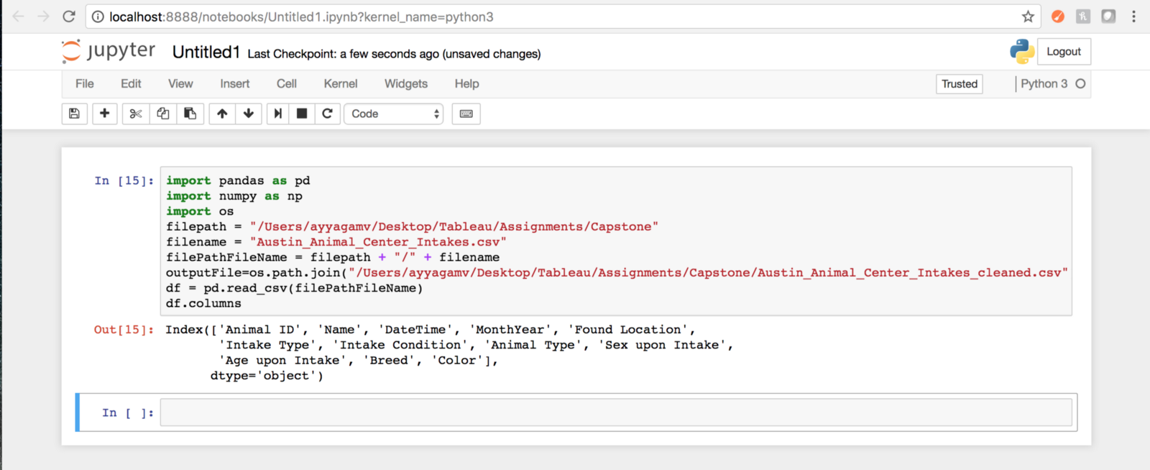
Appendix A: Cleaning data with Python
Data scientists spend a large amount of their time cleaning datasets and getting them down to a form with which they can work. In fact, a lot of data scientists argue that the initial steps of obtaining and cleaning data constitute 80% of their job.
Tasks - Using Pandas Library
Dropping unnecessary columns in a Pandas DataFrame
Using .str() methods to clean columns
Using the DataFrame.applymap() function to clean the entire dataset, element-wise
Renaming columns to a more recognizable set of labels
Skipping unnecessary rows in a CSV file
Resource: Python for Data Analysis (O’Reilly)
*Cleaining Strings in python: https://mode.com/sql-tutorial/sql-string-functions-for-cleaning/
Notes:
Common ways to clean data with Python are available in the many libraries that you can import in your code. One of the most popular libraries is Pandas, which was designed for data manipulation and analysis, but is most commonly associated with data cleaning. Here is a common code snippet where Pandas is imported to clean a set of data:

